Slide 1
CS 4530: Fundamentals of Software Engineering Module 5: React Basics
Adeel Bhutta
Khoury College of Computer Sciences
© 2026 Released under the CC BY-SA license

Slide 2
Learning Objectives for this Lesson
By the end of this lesson, you should be able to:
Understand how the React framework binds data (and changes to it) to a UI
Create simple React components that use state and properties
Notes:
Tonight's subject is REACT, our web framework. We have two lessons,
roughly: basic REACT, and advanced REACT.
<Read slide>

Slide 3

HTML: The Markup Language of the Web
Language for describing structure of a document
Denotes hierarchy of elements
What might be elements in this document?
Notes:
HTML is the markup language of the Web.
It is a language for describing the structure of a document.
And it does so by denoting the hierarchy of elements in the document.
On the right, we see an article from a newspaper and an electronic version of it.
We can see that the article has a title, a subtitle, an image, and multiple paragraphs in it.
These are all elements that can be found in html.

Slide 4
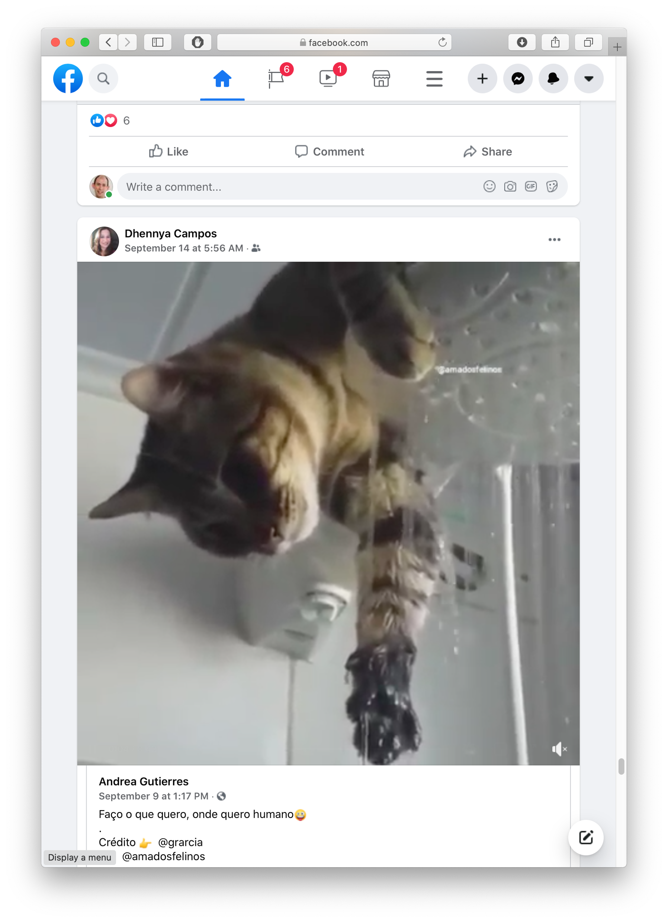
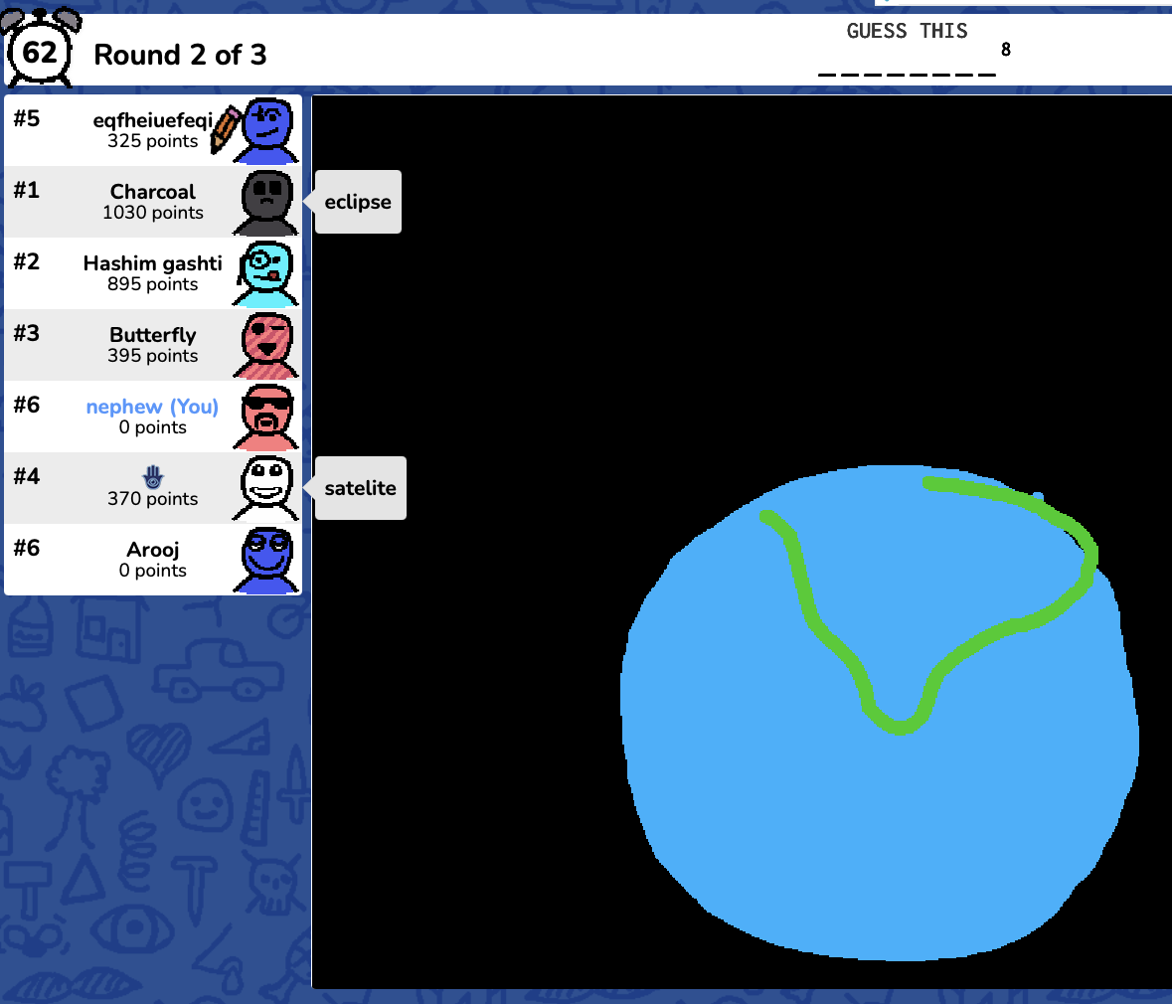
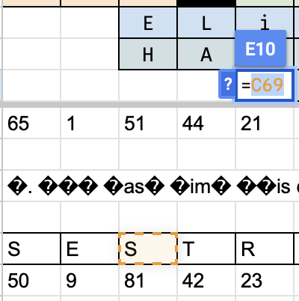
Rich, interactive web apps
Notes:
HTML only gives us only static web apps.
In order to build more complicated logic and add interactivity, we need to add JavaScript.
Infinite scrolling pictures of cats, complicated and reactive spreadsheets, and collaborative games all operate by using JavaScript to manipulate and modify the documents that HTML describes, but in practice, the tools baked in to JavaScript for doing have proven to be very difficult to use.
Therefore, almost all web development happens with tools that have been built on top of JavaScript which make dealing with the software engineering aspects of Web UI development (design, construction, and maintenance of large programs over time!) more palatable. React is one of these.

Slide 5

Typical properties of web app UIs
Each widget has both visual presentation & logic
Some widgets occur more than once
e.g., comment/like widgets
Changes to data should cause changes to widget
e.g., new images, new comments should show up in real time
Widgets have hierarchical structure
Action on a widget may affect other widgets
e.g., clicking on 'like' button executes some logic related to the widget itself,
It may also affect the widget that contains the ‘like’ button
Notes:
Most of the “frameworks” — the tools that have been built on top of javascript — have some opinion about what it means to build a web application, or what a web application looks like.
Interactive web apps are made up of widgets. A widget is an element with which a user interacts.
It has visual representation, as well as logic.
A widget might appear multiple times on a single page, such as the like and comment widget for each image.
And any changes to the data should update the widget.
Such as new images or comments showing up in real time.
For example, Clicking on a like button executes some logic related to it.
Logic and presentation of a widget are strongly coupled, but different widgets are loosely related.
But how do we build such widgets?

Slide 6
Components represent widgets in object-like style
Organize related logic and presentation into a single unit
Includes necessary state and the logic for updating this state
Includes presentation for rendering this state into HTML
Synchronizes state and visual presentation
Whenever state changes, HTML should be rendered again
Notes:
Components organize the logic and presentation into a single unit.
This includes the state, and the logic necessary to update the state.
And it also includes the presentation for rendering this state.
Components also synchronize the state with its presentation, meaning that whenever the state changes, this updated html is rendered to the screen.

Slide 7
Components Example: Like button component
What does the button keep track of?
Is it liked or not
What post this is associated with
What logic does the button have?
When changing like status, send update to server
How does the button look?
Filled in if liked, hollow if not
Notes:
Let's go a little deeper into components and understand the like button component in terms of the data and presentation it needs to manage.
So, what does the like button keep track of?
It tracks whether the post is liked or not,
And it keeps track of what post it is associated with.
What logic does this button have?
When the like status is changed, it sends an update to the server.
And how does it look?
It is filled in if the post is liked and is hollow if not.

Slide 8
React is a Framework for Components
Created by Facebook
Powerful abstractions for describing UI components
Official documentation & tutorials: https://reactjs.org/
Components are constructed in the browser (“front-end”)
Key concepts:
Embed HTML in TypeScript
Track application “state”
Automatically and efficiently re-render page in browser based on changes to state
But: some implementations of React allow components to be pre-constructed in the server.
Notes:
And finally, we are going to talk about React!
React is a front end framework for building components.
It was created by Facebook in May of 2013.
It provides powerful abstractions for creating and describing components.
Some of the key concepts that we will cover include:
Embedding HTML in Typescript.
Tracking application state.
And how React automatically and efficiently re-renders parts of the page through a process called reconciliation.

Slide 9
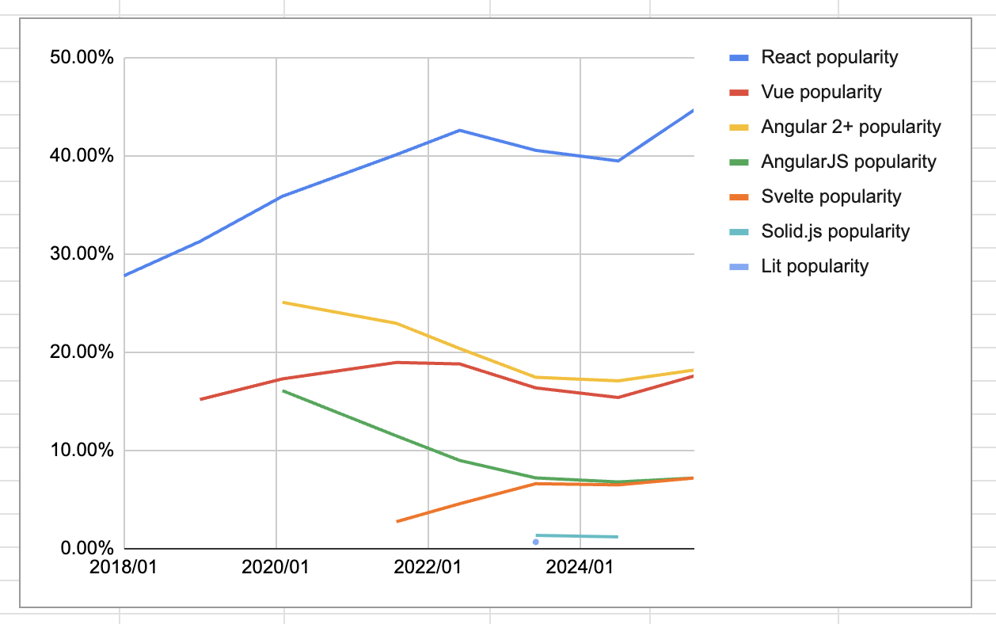
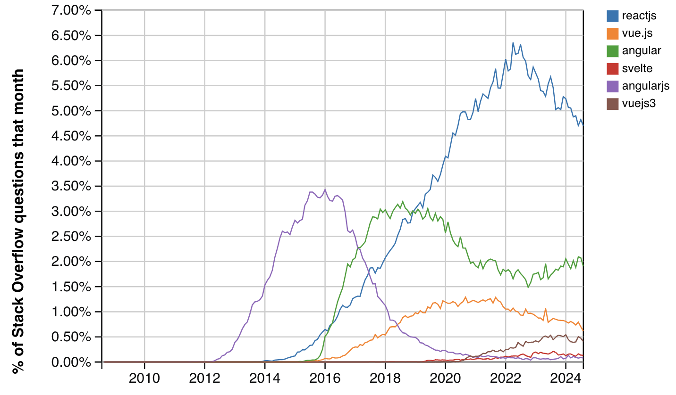
React Is a Dominant Force in Web Development
# of all questions on stack overflow
“have you done extensive development work in this over the past year” (Stack Overflow)
https://gist.github.com/tkrotoff/b1caa4c3a185629299ec234d2314e190
Notes:
React is and has been among the most popular frameworks for front end development for the past decade, and is used in a substantial percentage of all websites, including Facebook, Instagram, and AirBNB. A substantial percentage of all websites — something like 3% according to some estimates — use React.

Slide 10
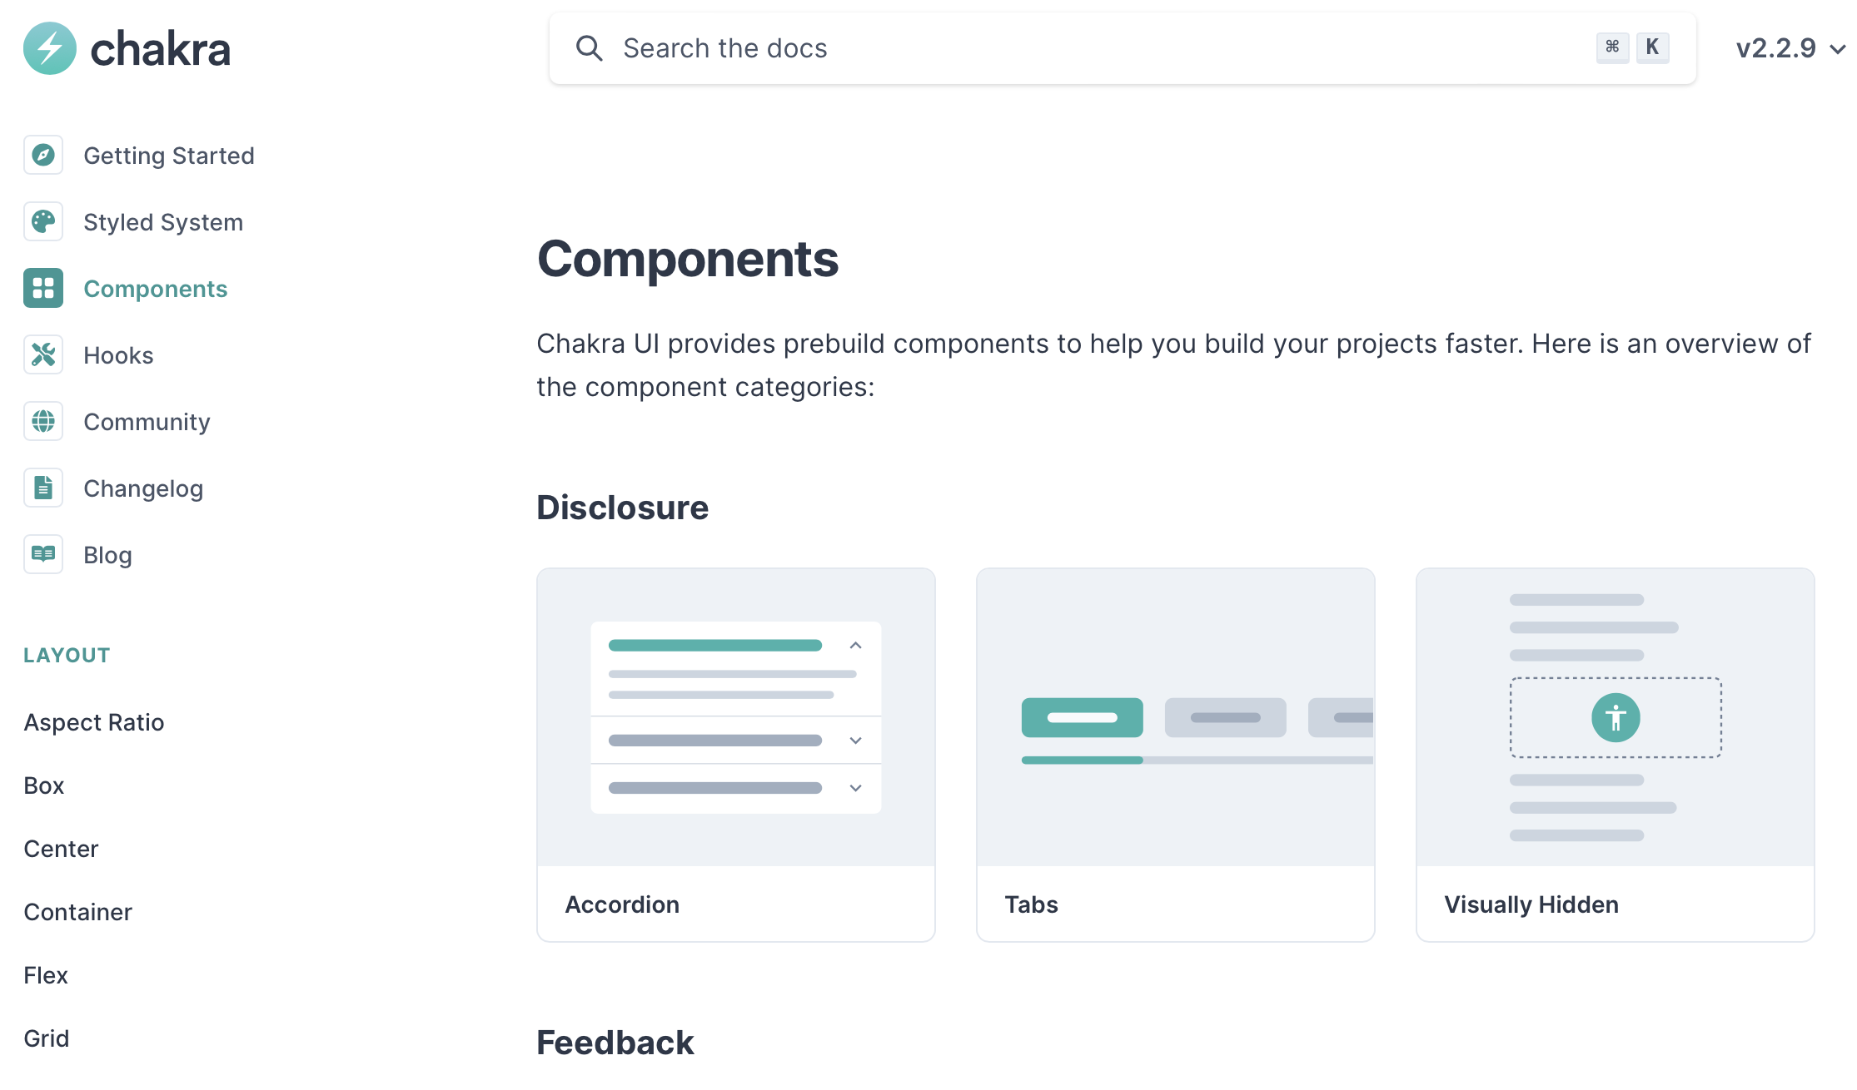
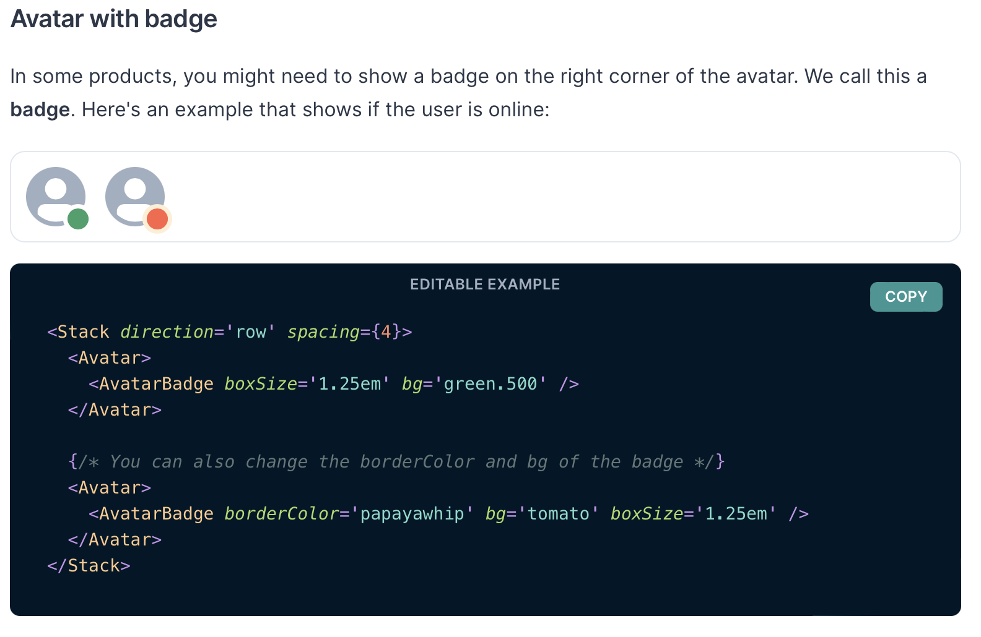
React facilitates building reusable libraries of components
Notes:
Part of the idea with components is that they can be easily packaged up, shared, and reused. In the preceding video, we saw a couple of examples of these: the IconButton, and the heart icon. These components come from a popular React component library called Chakra UI. The Chakra UI web page lists all of the components in the library, and we show another example component on the right - the avatar component.
Chakra UI is one example because it was built from the ground up to be compliant with web accessibility standards - it is possible to make accessible application using other frameworks, too, but starting with accessibility in mind is a good practice to ensure that you do not inadvertently create something that is challenging to adapt.
Other popular component libraries include Material UI and ANT Design.

Slide 11
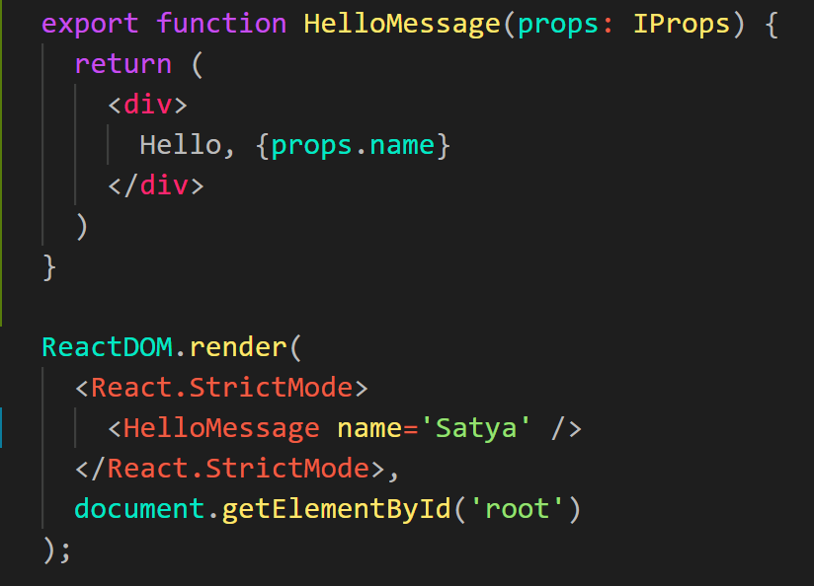
Embedding HTML in TypeScript Aka JSX or TSX
How do you embed HTML in TypeScript and get syntax checking?
Idea: extend the language: JSX, TSX
JavaScript (or TypeScript) language, with additional feature that expressions may be HTML
It’s a new language
Browsers do not natively run JSX (or TypeScript)
We use build tools that compile everything into JavaScript
Notes:
In React, we embed our HTML in Typescript with something called JSX (or TSX for the typescript version) — which is JSX for Java.
JSX is a new language — browsers do not run JSX natively (they don’t run TypeScript natively either! Node only started running typescript natively, via type stripping, very recently). It has to be compiled to javascript.
Every framework — Angular, React, Vue, Svelte — is a new language that compiles to JavaScript. Sometimes it looks more like JavaScript being embedded in HTML. Compared to other frameworks, React is pretty close to just writing JavaScript — the XML tags get macro-expanded into a calls to function calls to a `createElement` function that takes as its first argument the type of element (like div or HelloMessage), the second argument the parameters (like that ”name” is “Satya”) and as a third argument the children — HelloMessage is the one child element of React.StrictMessage.

Slide 12
JSX/TSX Embeds HTML in TypeScript
Example:
HTML embedded in TypeScript
HTML can be used as an expression
HTML is checked for correct syntax
Can use { expr } to evaluate an expression and return a value
e.g., { 5 + 2 }, { foo() }
To wrap on multiple lines, wrap the TSX/JSX in parentheses (…)
Value of expression is a piece of HTML
return <div>Hello {someVariable}</div>;
Notes:
React uses an extended syntax to include HTML in Typescript.
This allows us to use HTML as an expression in typescript.
An example of this is returning an html element instead of a value or variable.
This allows the html to be checked for correct syntax.
And within this html element, we can add expressions using the curly braces.
For example, writing 5 + 2 in the curly braces would print 7 in the html.
Similarly, calling the function foo() would evaluate the value that foo returns.
We can use this expression to bind data from our component to the html.

Slide 13
Hello World in React
src/Components/HelloWorld.tsx
import * as React from 'react';
import { Heading, VStack } from '@chakra-ui/react';
export default function HelloWorld() {
return (
<VStack>
<Heading>Hello World</Heading>
</VStack>
);
}
“Return this HTML whenever the component is rendered”
The HTML is dynamically generated by the library.
In our repo, demo this by executing "npm run dev" in a shell and opening your browser to the place it tells you (usually localhost:3000)
Notes:
OK! Here is our first React component.
Here we’ve defined a “Hello World” component The name must begin with a capital letter and it must return some html. Here’s we’ve returned some styled html using the Chakra UI library.
We'll demo this in a moment.
This component contains no logic or data and returns the same html every time. You could add some logic so that it didn't return the same html every time-- that's the main subject of this lecture.
Note: there's no connection between the name of the exported function (HelloWorld), and name of the file from which it is exported (HelloWorld.tsx). We choose the names to be the same just to prevent confusion.

Slide 14
In our repo, you can choose which app you want in src/AppChooser.tsx
import { ChakraProvider } from '@chakra-ui/react';
// import App from './Components/HelloWorld.tsx';
// import App from './Components/HelloWorldAveryAndDave.tsx';
// import App from './Components/TwoCountingButtons.tsx'
import App from './Apps/ToDoApp/ToDoApp.tsx';
export default function Main() {
return (
<ChakraProvider>
<App />
</ChakraProvider>
);
}
This is just how we've set it up for you. Other repos, and other React implementations, may do it differently
In our repo, demo this by executing "npm run dev" in a shell and opening your browser to the place it tells you (usually localhost:3000)
Notes:
If you try this, you'll see a whole bunch of other imports, pointing to all the different apps that we have in this module (and the next). Simply uncomment the one that you want (and comment out any others).
If you remember, HelloWorld.tsx default-exported a function that it called HelloWorld, but here we are importing it as 'App'-- the import line says "take the default export from the file HelloWorld.tsx and call it 'App'. By using this convention, we don't have to remember which files exported their components under what names. "export default" is your friend ☺.
<now demo helloworld>

Slide 15
React Components are Little Machines
They start with input from their creator (parent) (props)
They have additional local state ("component state")
They retain their local state when their parent's state changes
They may change their local state in response to external stimuli (button presses, etc.)
They re-render when their local state changes, or when they are re-created by their parent with different props.
Generally, best practice is to keep most of the state in the parent component.

Slide 16
Component State is Data That Changes
State is created by useState.
The state is accessed through state variables in the component.
The first variable is the accessor, the second is the setter.
The only way to change the value of a state variable is with the setter
In general, the state consists of several variables.
The component only re-renders after its local state changes
import { useState } from 'react';
function Foo() {
const [count, setCount] = useState(0)
….
}
You could choose any names for the variable and its setter; for this class, please follow the naming convention (goodVariableName, setGoodVariablename) that we’e used here.
Notes:
“State” is component data that changes. It is important to distinguish data that doesn’t change from data that does change because changes to data should result in the component re-rendering. That is, when the data changes, we want our component to “react” to the change visually.
With React, we define state variables by calling the special method “useState”. `useState` takes a single parameter, which defines the default value of the state.
It returns an array with two elements: the first element is the value of the state variable, and the second is a setter which is used to change the state variable - the code on line 3 of the example on the right is typescript shorthand for saying: “declare a variable `count`, and set it to the first element of the array returned by useState, and declare another variable `setCount`, and set it to the second element in that array”
All updates to state must be made through the setter function.
React doesn’t care what names you choose for these variables; however for this class, we care that you choose a good variable name (as covered in our general design principles), and call the setter something like “setGoodVariableName”

Slide 17
Example
src/Components/SimplestState.tsx
export default function SimplestState() {
const [count, setCount] = useState(0)
function handleClick() { setCount(count + 1) }
return (
<VStack>
<Box> count = {count} </Box>
<Button onClick={handleClick} >
Increment Count!
</Button>
</VStack>
)
}
(Some styling has been removed to reduce clutter on this screen. Look at the file for details}
Notes:
When the user clicks on a button, the button’s onClick property is called. Here we've told the button that its onClick property should be the function handleClick.
handleClick, in turn, invokes the setCount function, which sets the `count` variable to its current value + 1.
<Demo>

Slide 18
Components don't change their state directly
export default function SimplestState() {
const [count, setCount] = useState(0)
function handleClick() {
setCount(count + 1)
}
return (
<VStack>
<Box> count = {count} </Box>
<Button onClick={handleClick} >
Increment Count!
</Button>
</VStack>
) }
A setter is just a callback.
Every so often, React collects all the set requests it has received since the last redisplay.
React executes all the outstanding set requests.
Last, React redisplays the component with the new state.

Slide 19
Setters are not synchronous
src/Components/SimplestStatePlus3.tsx
A setter doesn’t change the state immediately: it is just a request to React to update the state when this component is redisplayed.
Consider the following:
function handleClick() {
setCount(count + 1)
setCount(count + 1)
setCount(count + 1) }
Console methods: https://developer.mozilla.org/en-US/docs/Web/API/console
Notes:
This is important: Setters don’t change the state immediately: they only tell REACT that the state should be updated on the next redisplay. If the current value of 'count' is 1, then setCount(count+1) generates a message to the REACT system that the value of 'count' should be changed to 2. But it doesn't change the value of 'count' immediately.
<Demo; the next value of count should be 2 once again>
In this example, the initial value of count is 1. So `handleClick` generates three copies of setCount(2) to React. So for the next redisplay, React sets the value of count to 2.
<Demo if time: change to setCount(count => count+1), also setCount(x => x+1)>
NOTE TO SELF: refer to https://react.dev/reference/react/useState which is encyclopedic!
https://react.dev/reference/react/useState#updating-objects-and-arrays-in-state

Slide 20
In general, an app in React is a tree of components
Each component has a single parent (except for the root component in page.tsx)
A component may have children, which are other components
A component initializes its children by passing them properties (typically called "props")

Slide 21
The parent passes properties to its children by name.
src/Components/HelloWorldWithAveryAndDave.tsx
export default function HelloWorldWithAveryAndDave() {
return (
<VStack>
<HelloWorldWithName name='Avery'/>
<HelloWorldWithName name='Dave'/>
</VStack>
)
}

Slide 22
A component receives properties from its parent as a record (a TS "object literal")
Properties are passed as a single argument to the component
Properties can not be changed by the component
export default function HelloWorldWithName(
props: { name: string }
) {
return (
<VStack>
<Heading>Hello, {props.name}!</Heading>
</VStack>
);
}
Notes:
(Read slide)

Slide 23
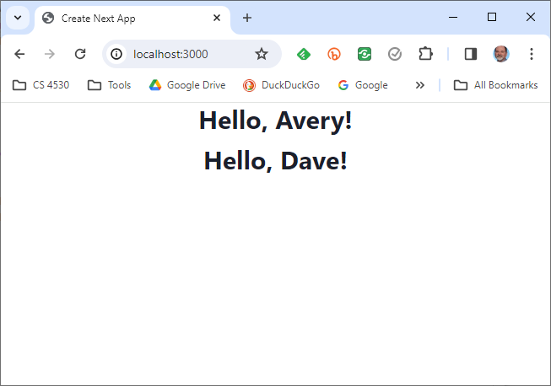

Slide 24
A component can pass handlers to its children
src/Components/TwoCountingButtons.tsx
import { useState } from 'react';
import { Box, VStack } from '@chakra-ui/react';
// create two CountingButtons, and keep track of the total count.
import CountingButton from './CountingButton.tsx';
export default function App() {
const [globalCount, setGlobalCount] = useState(0);
function incrementGlobalCount() { setGlobalCount(globalCount + 1); }
return (
<VStack spacing='30px'>
<Box border='1px' padding='1'>Total count = {globalCount} </Box>
<CountingButton name='Button A' globalCount={globalCount} onClick={incrementGlobalCount} />
<CountingButton name='Button B' globalCount={globalCount} onClick={incrementGlobalCount} />
</VStack>
);
}
Notes:
Let’s move on to how components can communicate with each other.
A common pattern is to nest components, passing values “down” from parents to children as props.
Here is an app that creates two CountingButtons, similar to what we had in the previous example. It passes each of them a name, and the handler it should use when it is clicked. The intention is that when the button is clicked, it should call incrementGlobalCount, which will increment the state variable globalCount.
<Demo>
In this example, you'll see some styling. In our examples, we've put in the smallest amount of styling to make the page easily readable. You can go to town with the styling-- Chakra has more styling options than you can count-- but we won't spend time on that because it doesn't advance our main story, which is the structure of React applications.
A good easy exercise is to modify this example so that each counting button also displays the global count.
React may complain that this example is missing an attribute called 'key'. Don't worry about that for the moment; we'll talk about that at the end of this video.

Slide 25
A child communicates with its parent by calling the handler it was passed
export function CountingButton(props: {
// display name of the button
name: string;
// global count from parent
globalCount: number;
// event handler to call when clicked
onClick: () => void;
}) {
const [localCount, setLocalCount]
= useState(0);
function handleClick() {
setLocalCount(localCount + 1);
props.onClick(); // propagate to parent
}
return (
<VStack>
<Box>
local count for {props.name} = {localCount}
</Box>
<Box>
globalCount = {props.globalCount}
</Box>
<Button onClick={handleClick}>
Increment {props.name}!
</Button>
</VStack>
);
}
src/Components/CountingButton.tsx
Notes:
And here’s the definition of CountingButton. The key bit of code is highlighted in yellow: handleClick, in addition to updating the local count, calls props.onClick, to invoke whatever handler the parent has passed to it.
If you think in terms of callbacks, you may find it helpful to think props.onClick as a callback to the parent.
Let's look at the preceding slide again to see what the callback does when it arrives at the parent.

Slide 26
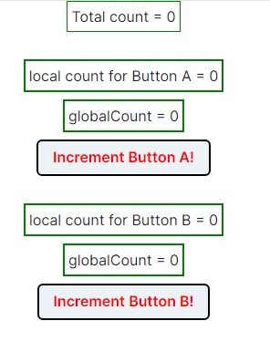
TwoCountingButtons demo
Notes:
<Demo, with console open>
Observe that pushing button A increments its own count, and also updates the total count. And similarly for button B.
Note: the demo may diff

Slide 27
Setters initiate the redisplay process
A setter sends a request to React.
Every so often, React collects all the set requests it has received since the last redisplay.
React executes all the outstanding set requests.
Last, React redisplays the component with the new state.
When a component re-renders, its children retain their state; the children are re-rendered only if their props change.

Slide 28
React works hard to make redisplay fast.
Updating the DOM in the browser is slow - it is vital that React does efficient diff’ing
Example: adding a new comment on a YouTube video shouldn’t make the browser re-layout the whole page
React makes re-rendering faster by updating only the part that changes.
This is called “Reconciliation”
https://react.dev/learn/render-and-commit
https://react.dev/reference/react/lazy

Slide 29
A New Pattern: display a list of items using map
export function ToDoListDisplay(props: { items: ToDoItem[],
onDelete:(id:string) => void })
return (
<Table>
<Tbody>
{
props.items.map((eachItem) =>
<ToDoItemDisplay item={eachItem}
key={eachItem.id}
onDelete={props.onDelete} />)
}
</Tbody>
</Table>
)
}
src/Apps/ToDoApp/ToDoListDisplay.tsx
(styling deleted)
Notes:
As we said, in all our previous examples, our parent component had a fixed number of children (in our case, two)
But what if we needed a variable number of children? For example, we might have a todo app that displays each item in a to-do list.
The solution to the problem is to use map. Evaluating the map gives a nice list of components, which are here displayed vertically (since they are rows in a table).
Let's look at this app in a little more detail.

Slide 30
But using map comes with a big gotcha.
export function ToDoListDisplay(props: { items: ToDoItem[],
onDelete:(id:string) => void })
return (
<Table>
<Tbody>
{
props.items.map((eachItem) =>
<ToDoItemDisplay item={eachItem}
key={eachItem.id}
onDelete={props.onDelete} />)
}
</Tbody>
</Table>
)
}
src/Apps/ToDoApp/ToDoListDisplay.tsx
(styling deleted)
Notes:
When you use map to display a list of items, each item must have a property that uniquely identifies it, and it must be called key. Otherwise, when REACT goes to redisplay the list, it doesn't know which elements are new and which are kept from the previous display.
Sometimes React will give you an error if you don’t pass a `key` attribute; sometimes it will just do strange wrong things.
Let's look at a typical example to see how to set up a key attribute.

Slide 31
The ToDo App
src/Apps/ToDoApp/ToDoApp.tsx
export default function ToDoApp () {
const [todoList,setTodolist] = useState<ToDoItem[]>([])
const [itemKey,setItemKey] = useState<number>(0) // first unused key
function handleAdd (title:string, priority:string) {
if (title === '') {return} // ignore blank button presses
setTodolist(todoList.concat({title: title, priority: priority, key: itemKey}))
setItemKey(itemKey + 1)
}
function handleDelete(targetKey:number) {
const newList = todoList.filter(item => item.key != targetKey)
setTodolist(newList)
}
return (
<VStack>
<Heading>TODO List</Heading>
<ToDoItemEntryForm onAdd={handleAdd}/>
<ToDoListDisplay items={todoList} onDelete={handleDelete}/>
</VStack>
)
}
Notes:
To illustrate this, let’s look at a ToDoApp. Here the master component keeps a list of todo items, and it has functions for handling a new item (coming from ToDoItemEntryForm), and for handling a deletion (coming from ToDoListDisplay).
It assigns a fresh key every time a new item is added.
Let’s look at this in action….

Slide 32
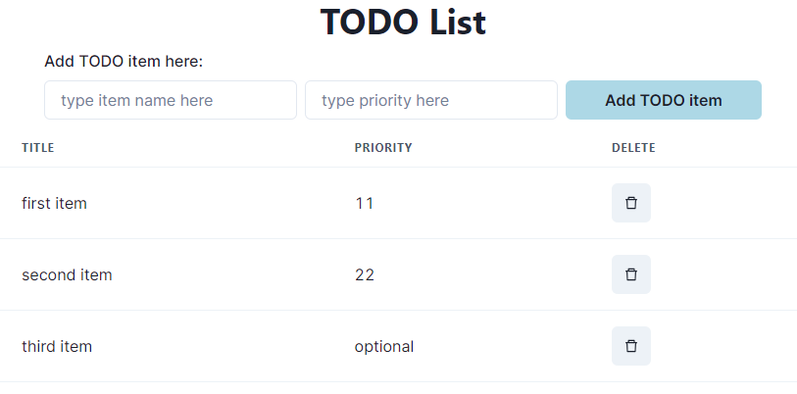
Typical Page
Notes:
Here's a typical page. As usual, we’ve used a minimum of styling.
<Do a demo, including adding items and deleting from the middle of the list>

Slide 33
A new pattern: an input form
src/Apps/ToDoApp/ToDoItemEntryForm.tsx
export function ToDoItemEntryForm (props: {onAdd:(item:ToDoItem)=>void}) {
// state variables for this form
const [title,setTitle] = useState<string>("")
const [priority,setPriority] = useState("")
const [key, setKey] = useState(0) // key is assigned when the item is created.
function handleClick(event) { --- } // on next slide…
return (
<VStack spacing={0} align='left'>
<form>
<FormControl>
<VStack align='left' spacing={0}>
<FormLabel as="b">Add TODO item here:</FormLabel>
<HStack w='200' align='left'>
<Input
name="title"
value={title}
placeholder='type item name here'
onChange={(event => {
setTitle(event.target.value);
console.log('setting Title to:', event.target.value)
})}
/>
The state of the form is kept in the state variables of the component
One <Input> component for each blank space in the form.
Update the state variable at every keypress
Notes:
Another thing we need to do is to get textual input into our app.
Here we set up an input form as what's called a "controlled component", meaning that the form entries are set in React component variables.
Inside the <FormControl> you'll have one <Input> component for each blank in the form. Our form has two blanks: title and priority. Here we've shown only the component for the title.
Look at the highlighted code. Every keypress fires the `onChange` callback with a piece of React data called an 'event'. event.target.value contains the current string in the form. On every keypress, we call setTitle with the current string in the form, so that the user can see what they've typed.
<Demo>

Slide 34
handleClick
function handleClick(event: React.FormEvent) {
event.preventDefault(); // don’t do the “default” of submitting the form
if (title === '') {
return;
} // ignore blank button presses
props.onAdd(title, priority); // tell the parent about the new item
setTitle(''); // resetting the values redisplays the placeholder
setPriority(''); // resetting the values redisplays the placeholder
}
Notes:
When we handle a click, signifying that we are ready to add the todo item, we send the data to the caller, using the `onAdd` procedure that the caller sent to us. Then we update the component variables to be ready for the next item. Resetting the values to their defaults causes the placeholder (e.g. 'type item name here') to be redisplayed.
preventDefault is preventing browser from default behavior which is typically a refresh — back in the ancient days of the web, you could click a button on a form and the browser would automatically send a POST request with no JavaScript, and that is still the “default” behavior. We need to prevent that default!
Since we are using react to control the rendering and re-rendering, we don’t need the browser to refresh to see changes.

Slide 35
Treat values of state variables as read-only
State can hold any kind of JavaScript value, including objects.
But you shouldn’t change objects that you hold in the React state directly.
Instead, when you want to update an object, you need to create a new one (or make a copy of an existing one), and then set the state to use that copy.
https://react.dev/learn/updating-objects-in-state
Notes:
One last gotcha before we go… <read slide>

Slide 36
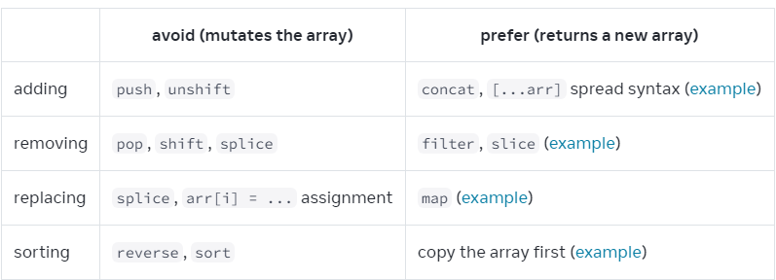
Array update cheat sheet
https://react.dev/learn/updating-arrays-in-state
Notes:
<read slide>
If you assign to a location in an array, React will not recognize it as a change, and your component will not update

Slide 37
Array update cheat sheet (2)
Replace 1 element at index i:
const result = arr.with(i, newvalue)
Remove 1 element at index i:
const result = [...arr.slice(0, i), ...arr.slice(i + 1)];
Insert elements at index i:
const result = [...arr.slice(0, i), ...items, ...arr.slice(i)];

Slide 38
Use spread syntax to update an object
const [position, setPosition] = useState({ x: 0, y: 0 });
position.y = 10;
setPosition(position); // this will not trigger a re-render
setPosition({ ...position, y: 10 }); // this works
const [anArray, setAnArray] = useState([1, 2, 3]);
setAnArray([...anArray, 4]); // this works, too
Notes:
You can also use the spread operator to update one field of an object, or to extend an array.

Slide 39
Review
Now that you've studied this lesson, you should be able to:
Understand how the React framework binds data (and changes to it) to a UI
Create simple React components that use state and properties
In the next module, we'll study another feature of React that enhances modularity: hooks.

